Slide 1
USE OF CSS IN AUTOMATION
rosario, January 2019

Slide 2
index
Introduction
Using css for locating elements in HTMlUsing XPath for locating elements in HTMl
Types of Css SelectorS
Universal Selectors
Atribute selectors
Class selectors
ID Selectors
Pseudo-Clases Selector
Sample HTML code
Locating elements
with Known Attribute
with known Element and Attributes
By Class
By Multiple Classes
By Class Name and Atribute
By multiple Atributes
Locating family elements
Locating a Child element
Locating a Descendant element
Validating and extracting CSS Selector
Quick Reference
Terminology
References

Slide 3
introduction
WHAT IS CSS
CSS stands for Cascading Style Sheets and is a simple design language intended to simplify the process of making web pages presentable.
With css developers can control from the color of a text as far as the different designs of a page depending on the device and screen in which a user access it.

Slide 4
Using css for locating elements in HTMl
A CSS Selector is a combination of an element selector and a value which identifies the web element within a web page.
They are string representations of HTML tags, attributes, Id and Class. As such they are patterns that match against elements in a tree and are one of several technologies that can be used to select nodes in an XML document.
Selectors may range from simple element names to rich contextual representations.
Notes:
See references on https://www.w3schools.com/xml/xml_xpath.asp

Slide 5
Types of Css Selectors
Universal Selectors
Atribute selectors
Class selectors
The universal selector, written as a CSS qualified name [CSS3NAMESPACE] with an asterisk (* U+002A) as the local name, represents the qualified name of any element type. It represents any single element in the document tree.
Example: #myid, *.warning,
Selectors allow the representation of an element’s attributes. When a selector is used as an expression to match against an element, attribute selectors must be considered to match an element if that element has an attribute that matches the attribute represented by the attribute selector.
Example: [att], [att = value]
An alternative to the attribute selector, when the class name is available it can be used as a CSS selector. Note that when a class have white spaces within, those are replaced by a “.”.
Example: div.value, div[class=value].

Slide 6
Types of Css Selectors
ID selectors
Pseudo-classes
Document languages may contain attributes that are declared to be of type ID. What makes attributes of type ID special is that no two such attributes can have the same value in a conformant document, regardless of the type of the elements that carry them; whatever the document language, an ID typed attribute can be used to uniquely identify its element. In HTML all ID attributes are named "id"; XML applications may name ID attributes differently, but the same restriction applies.
Example: #myid, tag[id = myid]
The pseudo-class concept is introduced to permit selection based on information that lies outside of the document tree or that cannot be expressed using the other simple selectors.
A pseudo-class always consists of a "colon" (:) followed by the name of the pseudo-class and optionally by a value between parentheses.
Example: E:nth-child(n), E:empty

Slide 7
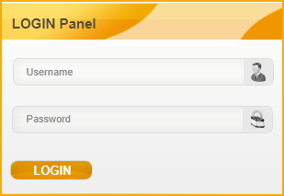
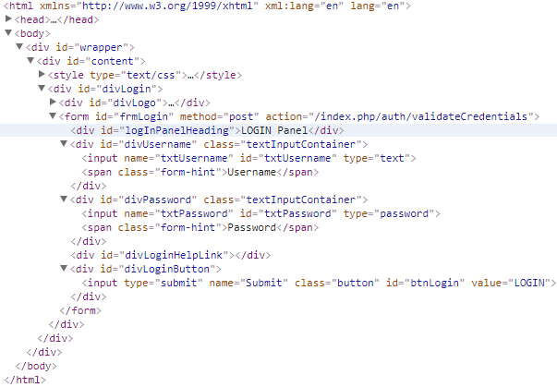
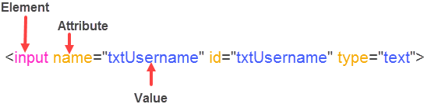
Sample HTML code
Following HTML will be used for the explaining XPath syntax.

Slide 8

Locating elements
with Known Value
with known Element and Attributes
The following syntax can be used for locating elements when at least one of the attribute value is unique and static (not changed).
Syntax:
[Attribute=’Calue’]
Let’s consider the username field
Example:
[id=’txtUsername’]
[name=’txtUsername’]
#txtUsername
//elementName[attributeName=’value’]
Examples :
input[id=’txtUsername’]
input[name=’txtUsername’]
Input#txtUsername

Slide 9
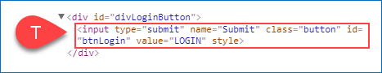

Locating elements
by Class
By Multiple Classes
Syntaxes :
Element.className .className
Let’s consider locating following element:
Examples :
input.button
.button
Syntax:
Element.className1.className2….classNameN
or .className1.className2….classNameNLet’s consider locating following element:
Let’s consider locating following element:
Examples :
div.box.searchForm.toggleForm.
box.searchForm

Slide 10
Locating elements
by class name and attribute
by multiple attributes
Syntaxes :
Element.className[Attribute=’Value’] or .className[Attribute=’Value’]
Let’s consider locating following element:
Examples :
input.button[name=’Submit’]
.button[name=’Submit’]
Syntax:
Element[Attribute1=’Value1’][Attribute2=’Value2’] ..[Attribute3=’Value3’] or [Attribute1=’Value1’][Attribute2=’Value2’] ..[Attribute3=’Value3’]
Let’s consider locating following element:
Examples :
input[id=’txtUsername’][name=’txtUsername’]
[id=’txtUsername’][name=’txtUsername’]

Slide 11
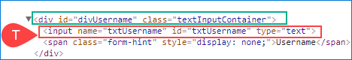
Locating elements
with Dynamic Attribute values
Following syntax could be used when a part of the attribute values are NOT changed. We can use the non changing value for locating the element. The following examples will display how to find an element if starts, contains and ends with an specific value respectively.
Syntax
Element[Attribute^=’prefix-of-the-value’] or [Attribute^=’prefix-of-the-value’]
Element[Attribute*=’any-part-of-the-value’]
Element[Attribute$=’suffix-of-the-value’] or [Attribute$=’suffix-of-the-value’]
Examples :
input[name^=’txtUser’] or [name^=’txtUser’]
input[name*=’User’]
input[name$=’name’] or [name$=’name’]

Slide 12
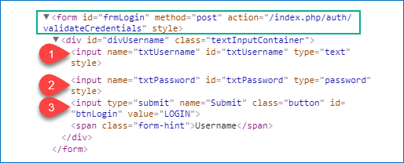
Locating family elements
Child Elements
Sometimes there will be more than one element for a given CSS. In cases like this we have multiple options like the ones below
Syntax:
CSS-of-Parent-Element>Element:nth-of-type(N)
CSS-of-Parent-Element>Element:first-child
CSS-of-Parent-Element>Element:last-child
Examples:
form>div>input:nth-of-type(1) The number one could be either of the three elements, in this case selects the first candidate
form>div>input first-child
form>div>input:last-child

Slide 13
Locating family elements
Descendant elements
When trying to find a descendant element is almost the same as a direct child. The difference is that we mention the ancestor and then proceed to replace the “>” for a white space. So the same rules apply for them.
Syntax:
CSS-of-Parent-Element<space>Element:nth-of-type(N)
CSS-of-Parent-Element<space>Element:first-child
CSS-of-Parent-Element<space>Element:last-child
Examples:
form input:nth-of-type(1) The number one could be either of the three elements, in this case selects the first candidate
form input first-child
form input:last-child

Slide 14
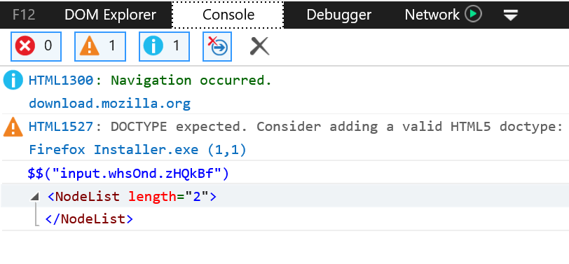
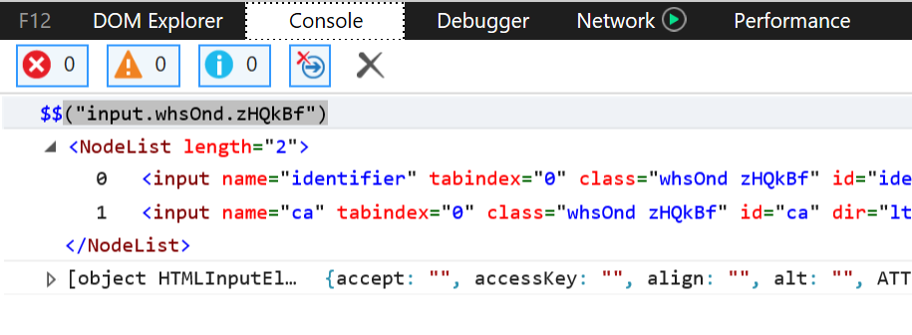
Validating and extracting Css Selector
The easiest way to validate a Selector is through the browser console by typing $$(“selector to find”).
- On IE the only thing that we will see is the amount of results that the CSS locator brings.
- Microsoft Edge will display the amount of results, but the list can be expanded to see more details about the element.

Slide 15
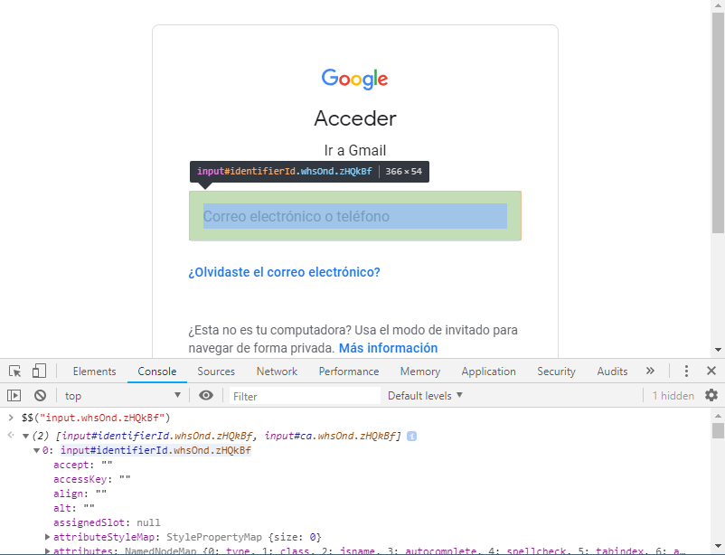
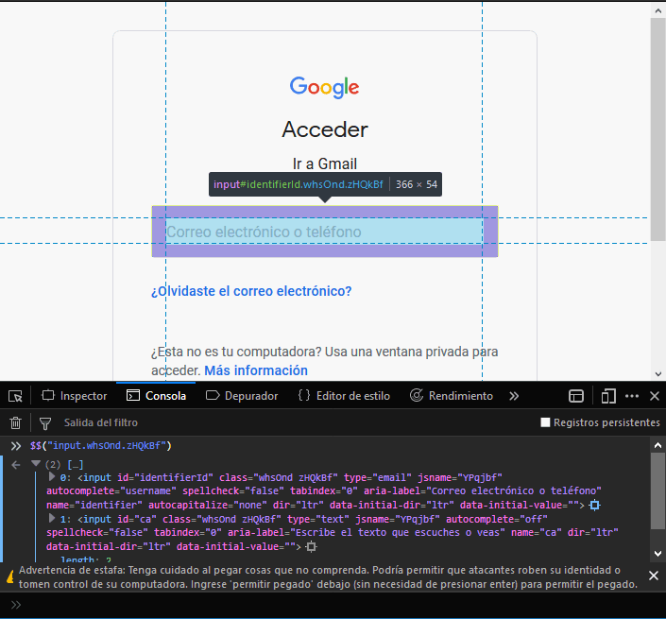
Validating and extracting Css Selector
- On both Chrome and Firefox will display the results the same way as Edge except that when you hover over the element form the list it is highlighted on the page.

Slide 16
Quick Reference
See the whole references on www.w3.org/TR/selectors-3/#selectors
Pattern | Represents | Description | Level
E | an element of type E | Type selector | 1
E[foo] | an E element with a "foo" attribute | Attribute selectors | 2
E[foo="bar"] | an E element whose "foo" attribute value is exactly equal to "bar" | Attribute selectors | 2
E[foo^="bar"] | an E element whose "foo" attribute value begins exactly with the string "bar" | Attribute selectors | 3
E[foo$="bar"] | an E element whose "foo" attribute value ends exactly with the string "bar" | Attribute selectors | 3
E[foo*="bar"] | an E element whose "foo" attribute value contains the substring "bar" | Attribute selectors | 3
E:nth-child(n) | an E element, the n-th child of its parent | Structural pseudo-classes | 3

Slide 17
Reference
http://pragmatictestlabs.com/2018/05/31/mastering-css-for-selenium-test-automation-2/
https://www.testingexcellence.com/css-selectors-selenium-webdriver/
https://saucelabs.com/resources/articles/selenium-tips-css-selectors
http://www.w3.org/TR/selectors-3/
https://drafts.csswg.org/selectors-3/
https://drafts.csswg.org/selectors-4/

Slide 18
Elias Zelarayan
engineer
Elias.Zelarayan@endava.com

